Slide 1
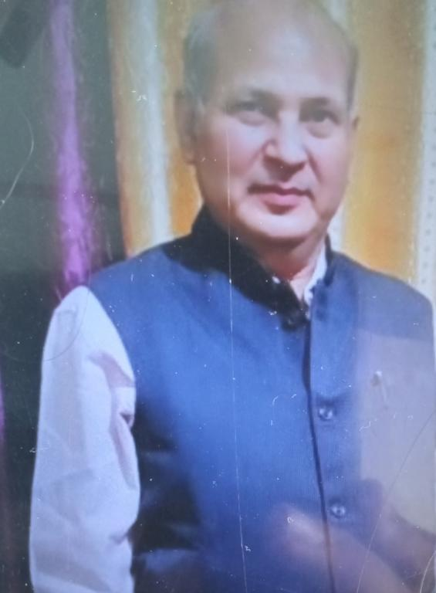
Limits and derivatives
By HC Verma Sir PGT maths
Saraswati Vidya Mandir
Rambagh Basti

Slide 2
Objective
1. *Understand the concept of limits*: Define and explain the concept of limits, including one-sided limits and infinite limits.
2. *Learn how to evaluate limits*: Apply various techniques to evaluate limits, such as direct substitution, factoring, and canceling.

Slide 3
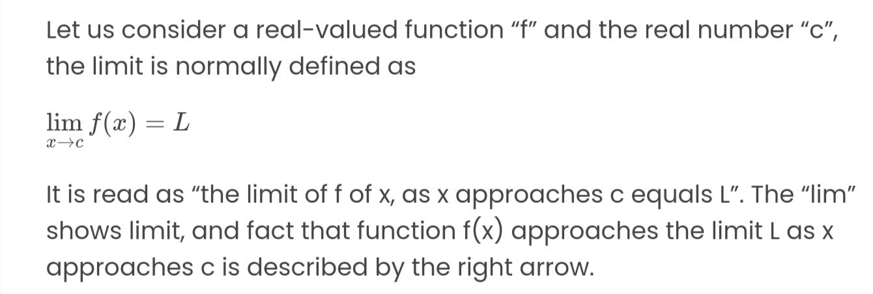
Limits

Slide 4
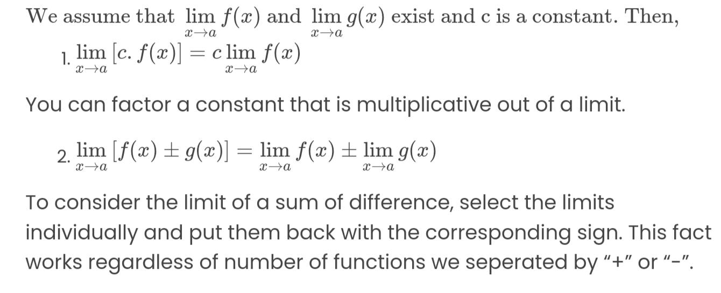
Properties of limits

Slide 6
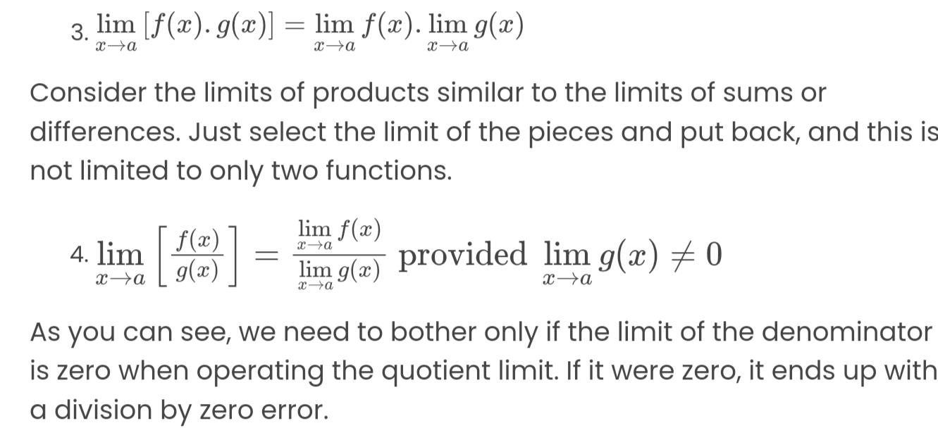

Slide 7
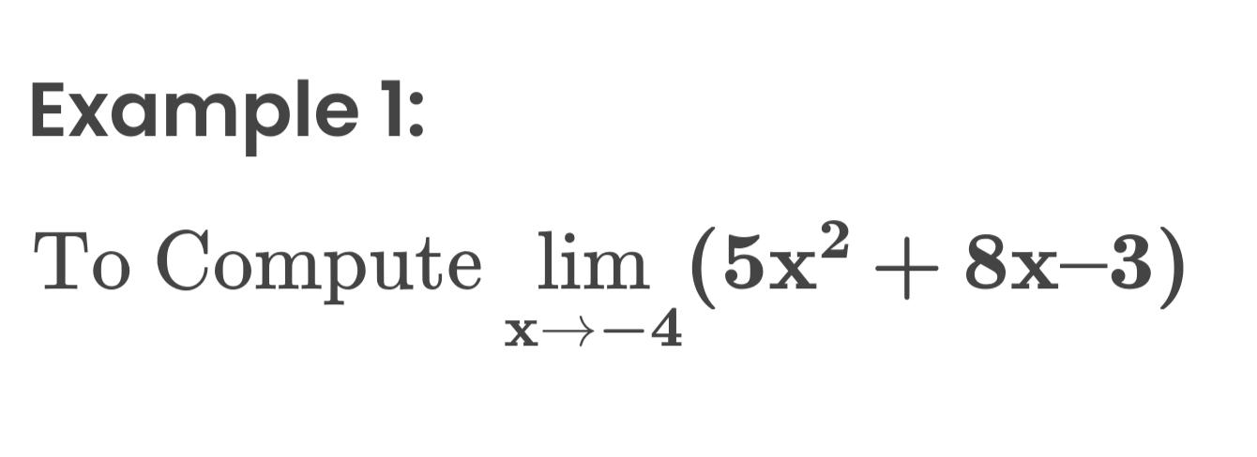

Slide 8
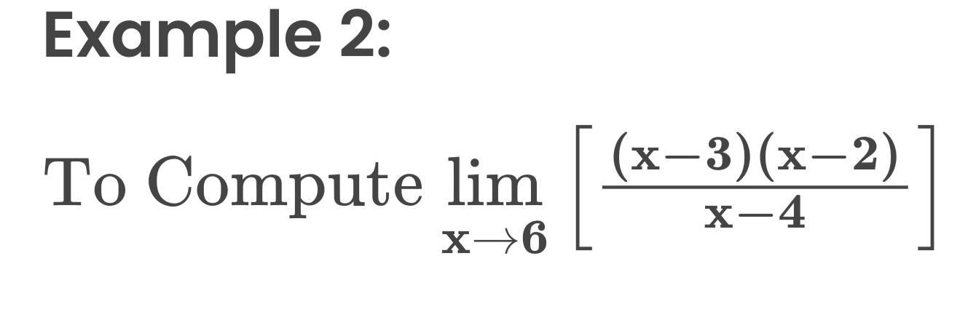

Slide 9
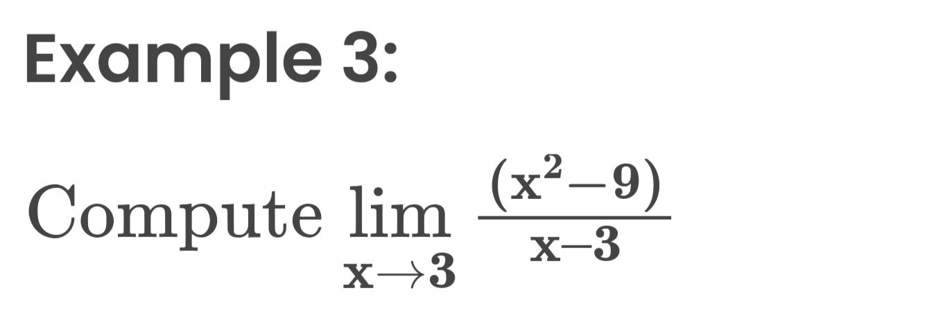

Slide 10


Slide 11
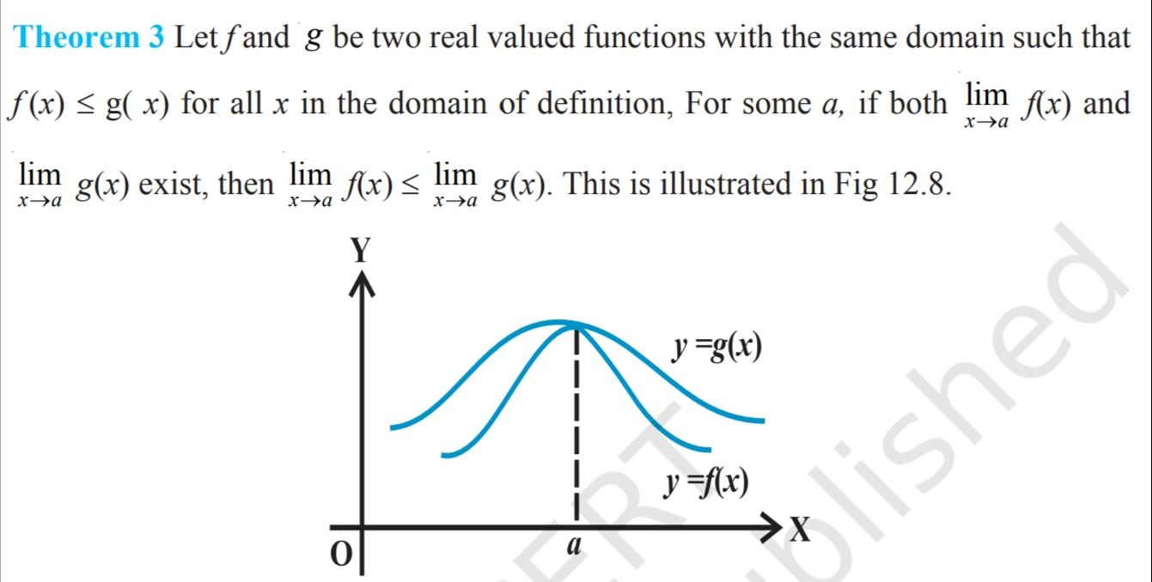

Slide 12
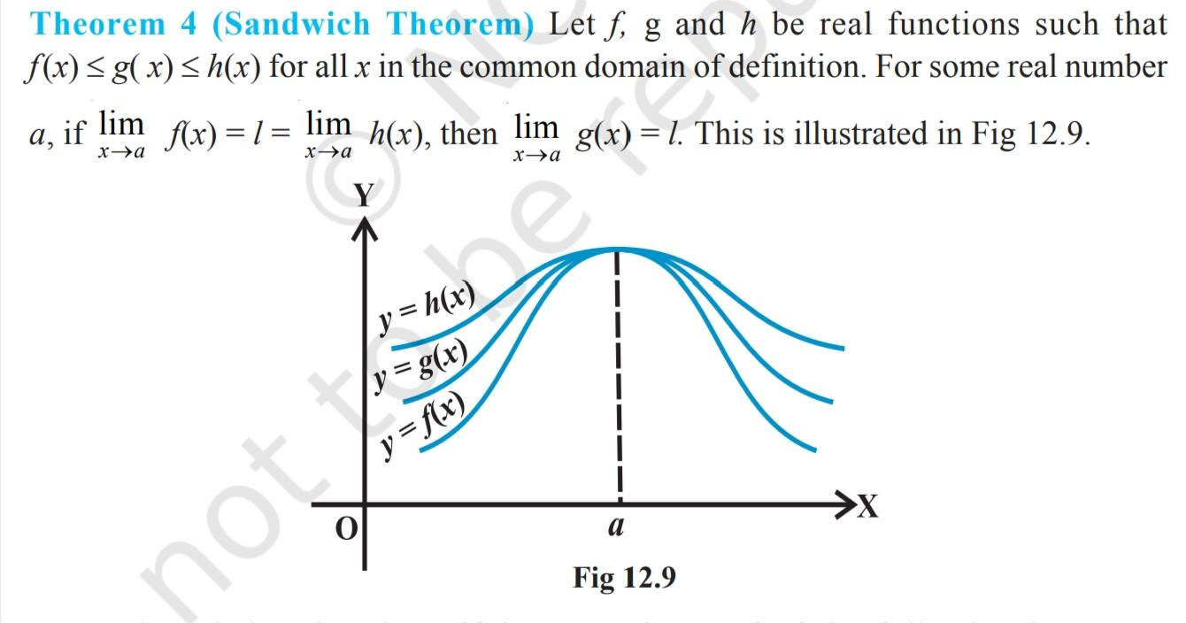

Slide 13
Proof of sandwich theorem

Slide 14

Some important trigonometry limits

Slide 15


Slide 16

Derivatives meaning

Slide 17

Definition of derivatives

Slide 18
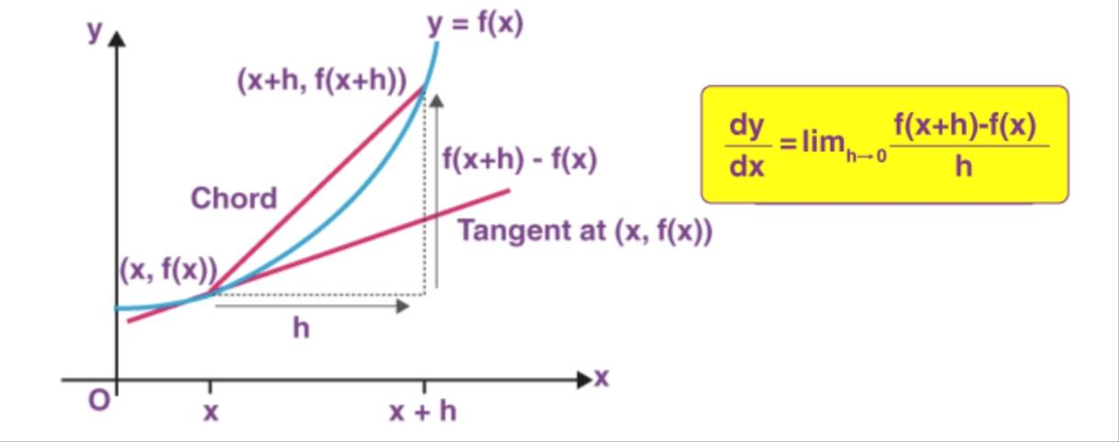

Slide 19


Slide 20


Slide 21


Slide 22


Slide 23
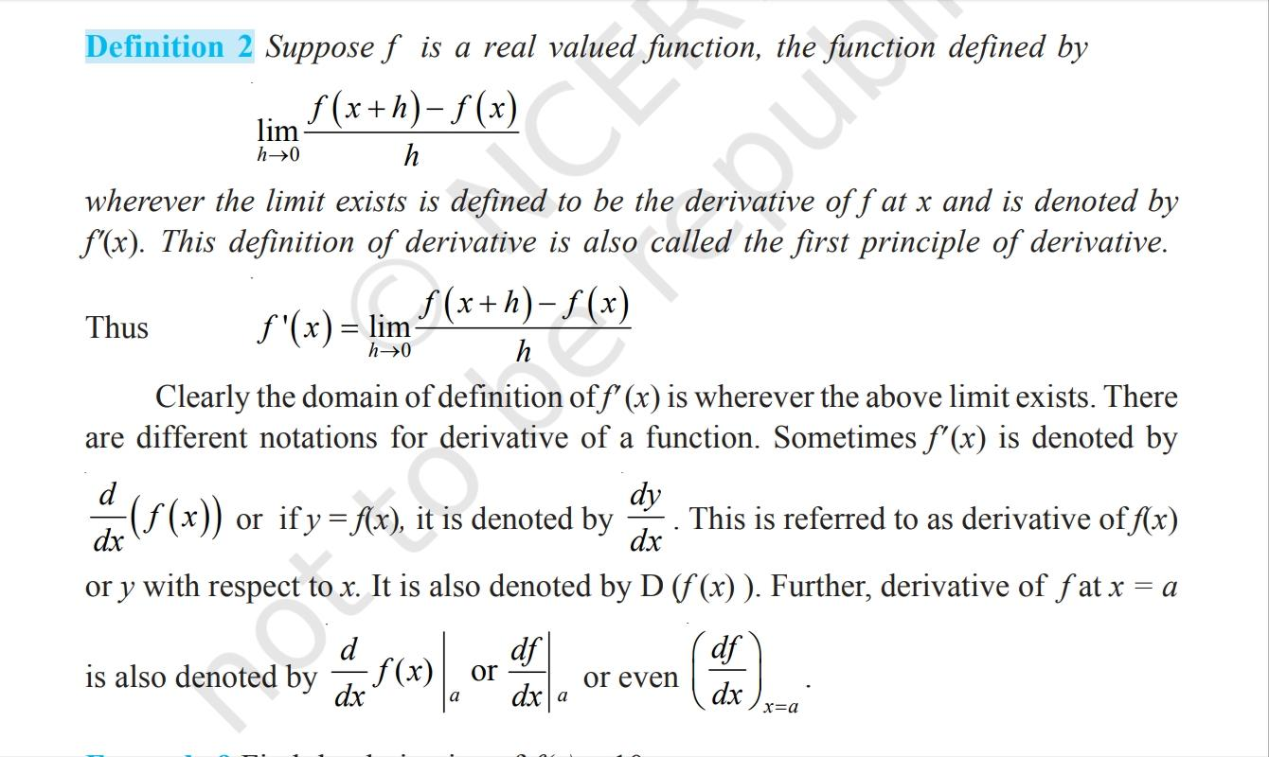

Slide 24


Slide 25


Slide 26


Slide 27


